Slide 1


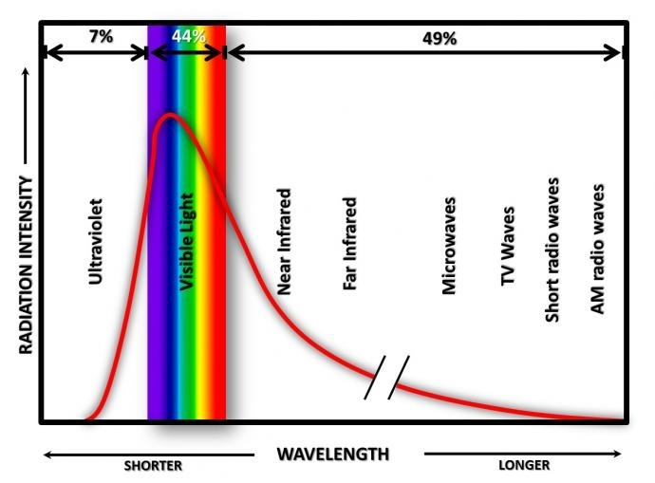
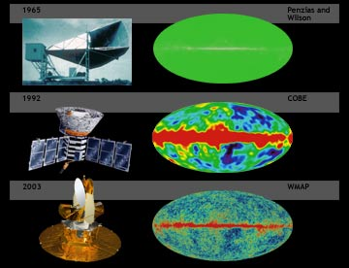
A Literature Review of Research on the Cosmic Microwave Background Southwestern Oklahoma State University
Hayden Webb | Dr. Jeremy Evert | Department of Computer Science
Abstract
Past Work
Wavelength Visualization
The objective of this research is to establish a better understanding of the current work available in the field of the Cosmic Microwave Background (CMB).
Our thesis is that, while the current state of research has created a base for the understanding of the CMB, more work is necessary through the use of computer science methods to expand upon the field. Our method of study is a literature review.
Our preliminary work suggests that NASA holds a wealth of information on this topic and has made it freely available to the public. Through our partnership with the OneOklahoma Cyberinfrastructure Initiative (OneOCII), we have access to the network and computing power to reproduce some of the analysis and then expand on the current body of work.
The Wilkinson Microwave Anisotropy Probe (WMAP) research team is a collaboration between Princeton University and NASA. The group’s first year paper set out to use more precise data than previous projects to test cosmological models. The WMAP enabled the group to more finely test measurements. The paper presented microwave maps in five separate frequency bands. These maps were used to confirm readings gather by COBE (Cosmic Background Explorer). The first-year paper tended to focus on refining and confirming information rather than exploring new avenues. The main take away from the first-year paper was a base line for future research. The group also showed that they can separate the CMB from other cosmological readings to produce a refined signal. The more precise data was then used to determine the age, temperature, and size of the universe. In the words of the WMAP team “We have demonstrated the ability to separate the CMB anisotropy from Galactic and extragalactic foregrounds. We provide masks for this purpose. In addition, we have produced CMB maps in which the Galactic signal is minimized” (Hinshaw G. et al. 2003). The WMAP team’s first-year paper began the first steps to understanding the CMB and using it as a tool. The WMAP team continued to refine their work and published a paper roughly each following year.
This diagram demonstrates the shift in wavelength the CMB will experience throughout its life span.
CMB History
Conclusion
The primary goal of the literature review was to establish a need for continuing research on the CMB.
A common theme among earlier works appears to be compounding information and verifying others works.
More recent CMB research appears to have become more specialized.
Modern papers are more likely to repeat each other rather than working in connection to affirm and expand on each other.
There also appears to be a lack of a standard for mapping that has been produced as of late.
More research is warranted in this field in order to reestablish a common modern standard.
Future projects should tend toward reaffirming information rather than exploring new avenues.
After the creation of a modern standard CMB research will potentially be more unified and driven.
CMB Definition
Like all explosions the Big Bang had a shock wave.
The CMB is a residual trace of the creation of the universe.
As the photons from the Big Bang travel across the universe they become effected by redshift.
The frequency is currently in microwaves and will eventually transition into radio waves.
The CMB is used as a standard to take measurements of the universe.
Groups have calculated the approximate age, temperature, and size of the universe off of the CMB.
Current Work
A recent example of CMB research is found in Yacine Ali-Haïmoud and Marc Kamionkowski (2017). Their paper seeks to discuss the relationship between the CMB and primordial black holes (PBHs). The paper was founded on that current theory that PBHs might comprise some or all of the universe’s dark matter. The paper looks at the effects of PBHs on the CMB temperature and polarization power spectra. Yacine and Marc attempt to accomplish this by computing the luminosity of PBHs while accounting for the drag and cooling caused by CMB photons. They also estimate the Schwarzchild radius and velocity of the primordial black holes by the surrounding gas. Yacine and Marc revised existing CMB limits to include the abundance of PHBs and noted that “We showed that CMB-anisotropy measurements by the Planck satellite exclude PBHs as the dominant component of dark matter…”. Primordial black holes are a rather recent develop in study of the CMB and will require more research as the field continues.
Works Cited
https://map.gsfc.nasa.gov/m_ig/030644/030644.html
https://www.quora.com/Why-are-we-still-receiving-CMB-photons-from-the-very-early-universe-given-at-that-time-380-000-years-after-the-Big-Bang-the-distances-between-the-origin-of-the-photon-and-our-location-would-have-at-most-800-000-light-years
http://iopscience.iop.org/article/10.1086/377253/pdf
https://arxiv.org/pdf/1612.05644.pdf

